Slide 1
Maker’s university – by intel’s makers community class 7 – getting started with the drone ☺
Gil Tal.
Mar 2020

Slide 3
Class 7 agenda:
What do we need to run a drone?
Basic knowledge we might be missing
Block diagram

Slide 4
What do we need?
Engines (motors) with rotors
Two ways LoRa Receiver\Transmitter for communication and control
GPS
Barometer for altitude
Gyro and Accelerometer
LiPo battery
Micro Controller with proper interfaces
Small removeable LCD for debug

Slide 5
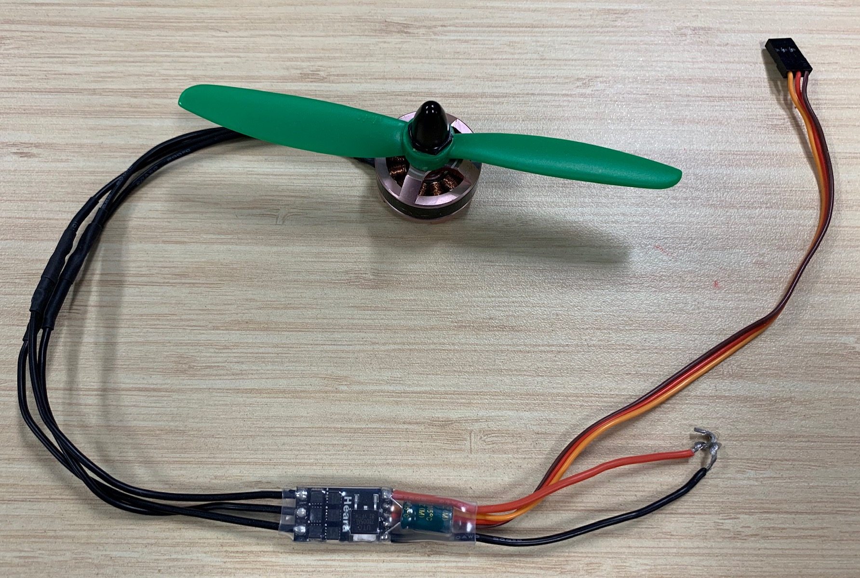
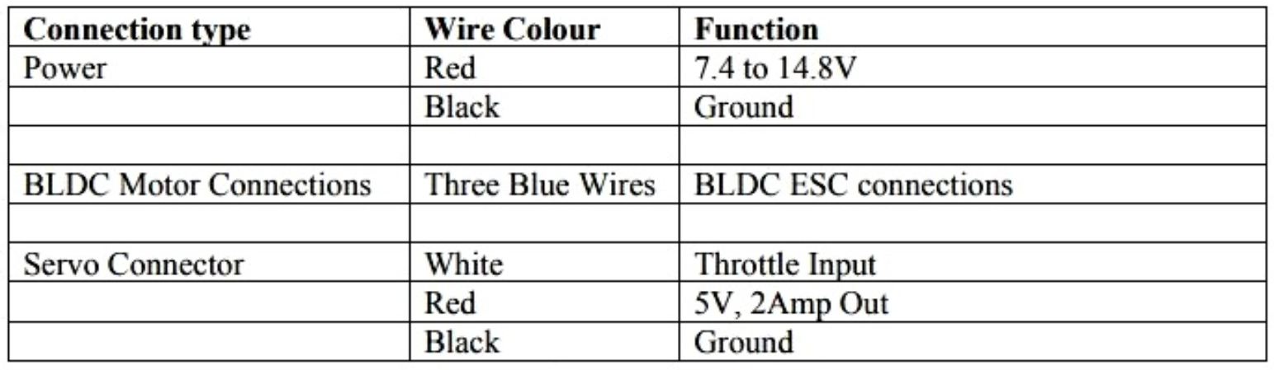
Engines with rotors
Brushless servo DC motor (high current 16-30A)
ESC (electronic speed control) is an electronic circuit that controls and regulates the speed of an electric motor
KV is Max RPM rating of the motor
ESC has 8 pins:
Servo
Connector
From LiPo Battery
(Via PWM)
ESC
Power

Slide 6
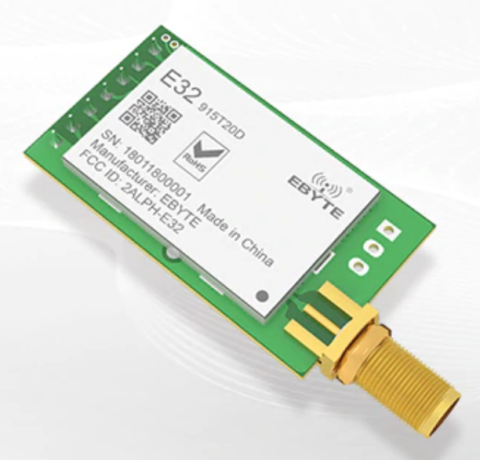
Communication
LoRa – Long range two ways LoRa Receiver\Transmitter
3-5 KM range
433/868/915 MHz
Uses UART protocol to communicate with the MCU
3.3V
Driver available for Ardunio

Slide 7
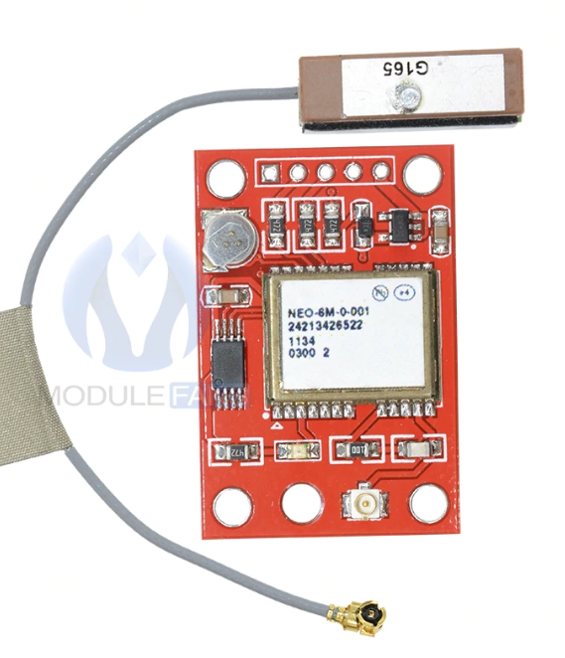
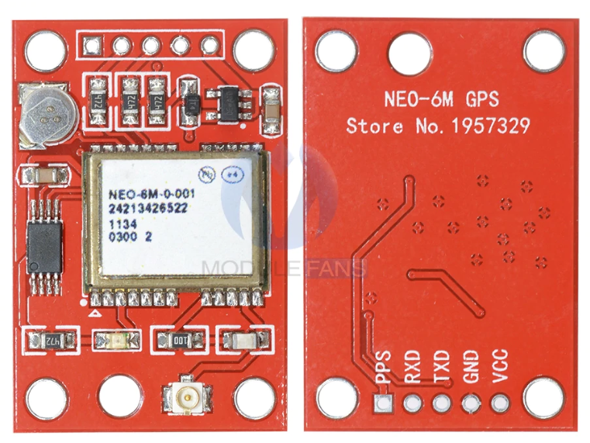
GPS
Uses UART protocol to communicate with MCU
3.3V
Driver available for Arduino

Slide 8
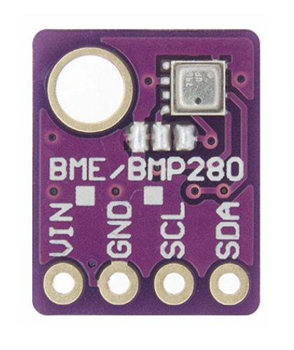
Barometer (BM280)
Uses I2C protocol to communicate with MCU
3.3V
Driver available for Arduino
Measures:
Humidity
Temperature
Pressure (For Altitude) – ~1m accuracy

Slide 9
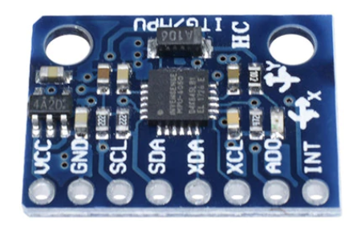
6050 MPU
3 Axis analog gyro sensors + 3 Axis Accelerometer
Uses I2C protocol to communicate with MCU
3.3V
Driver available for Arduino

Slide 10
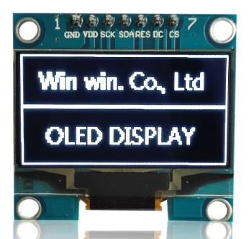
1.3” MINI LCD for debug
Uses SPI protocol to communicate with MCU
3.3V
Driver available for Arduino

Slide 11
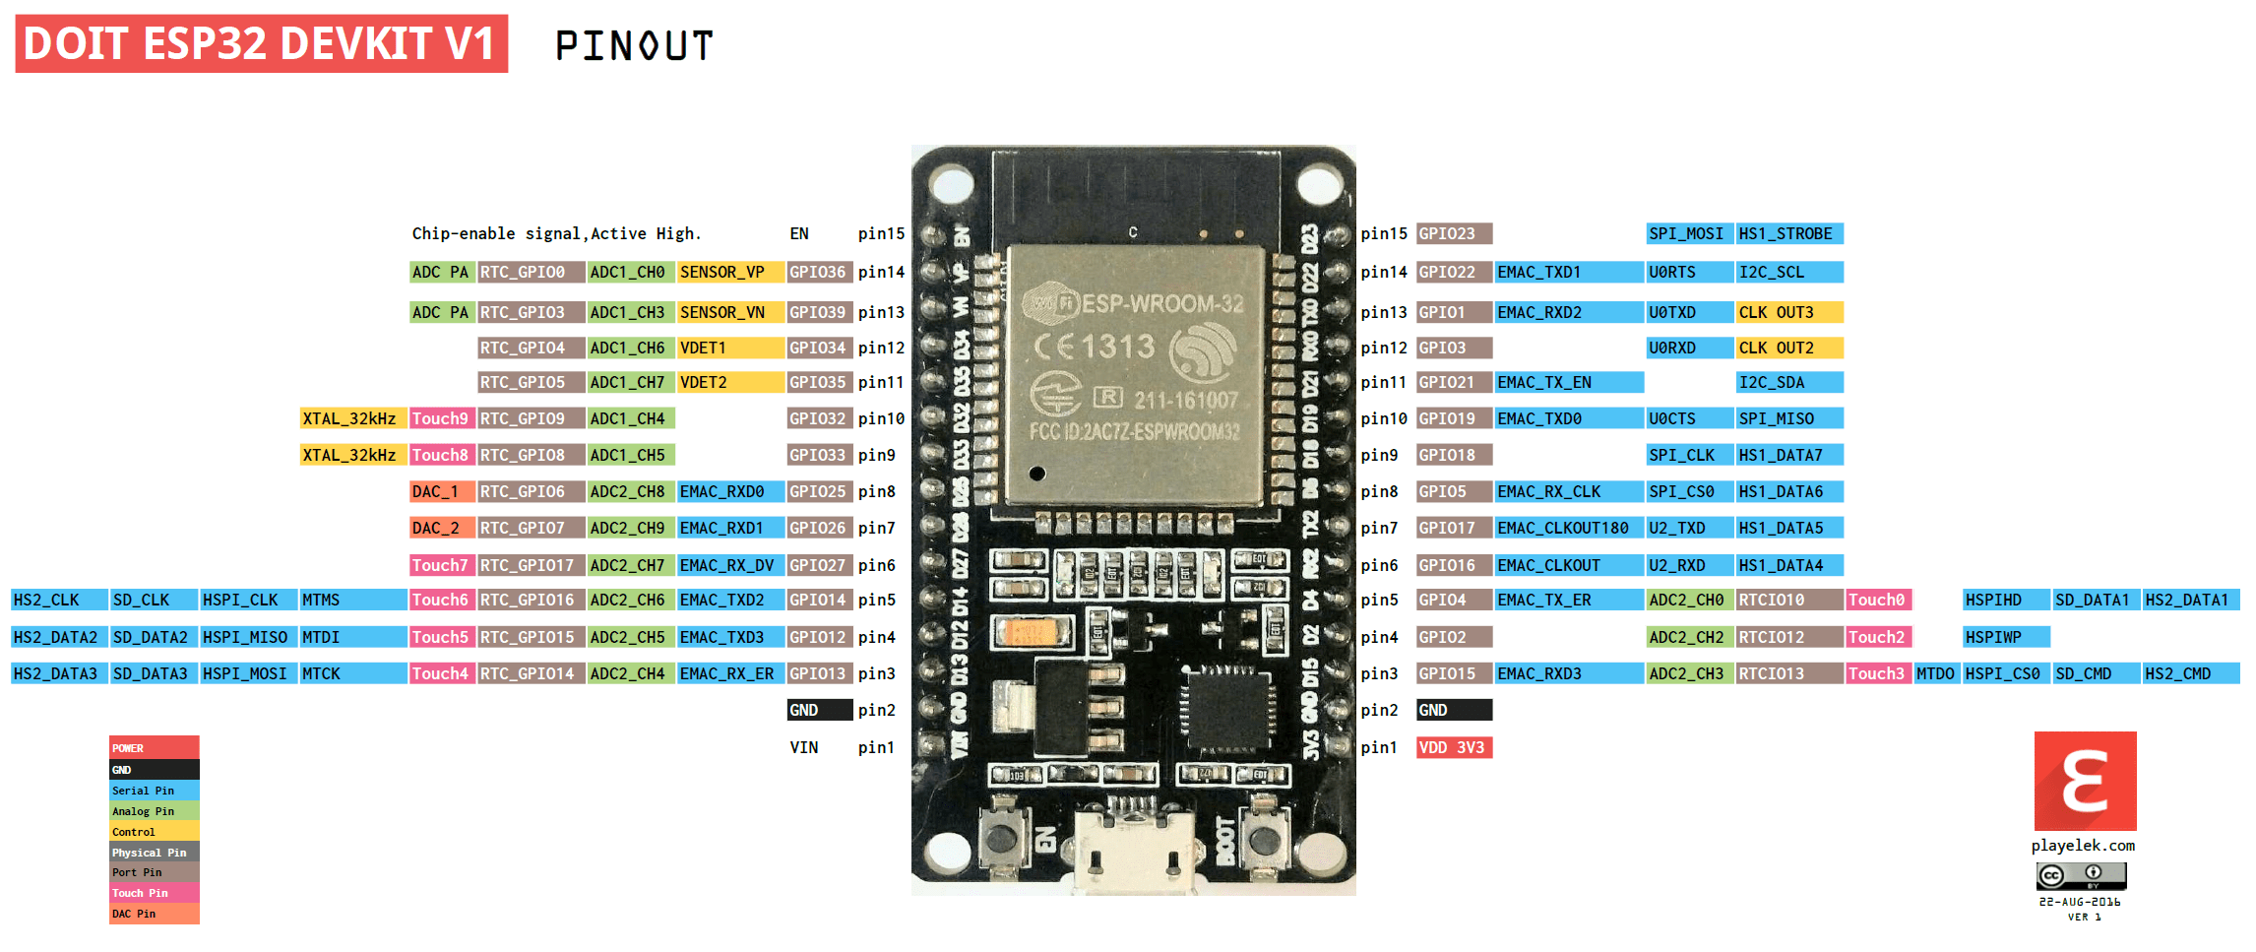
Our MCU – ESP32 Dev Kit

Slide 12
Block diagram
GPS
BM280
6050
UART
I2C
ESP32
Dev Kit
LiPo
Battery – XT60
Connector
LoRa
PWM
UART
SPI
LCD
Connectors for ESCs
GND
5V

